Slide 1
Transport Layer

Slide 2
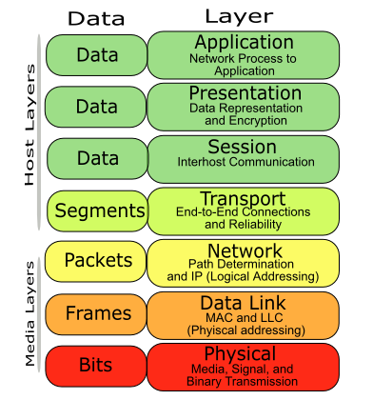
Host and Media Layer

Slide 3
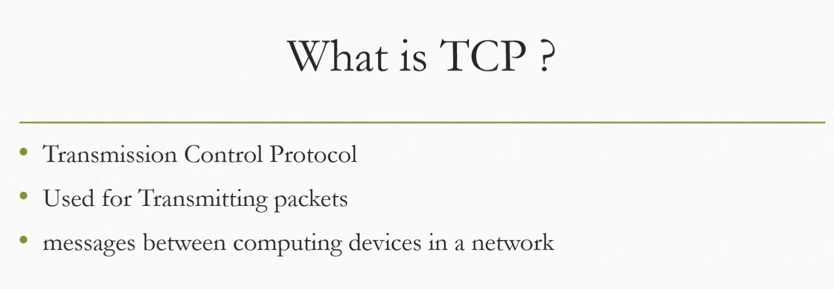

Slide 4
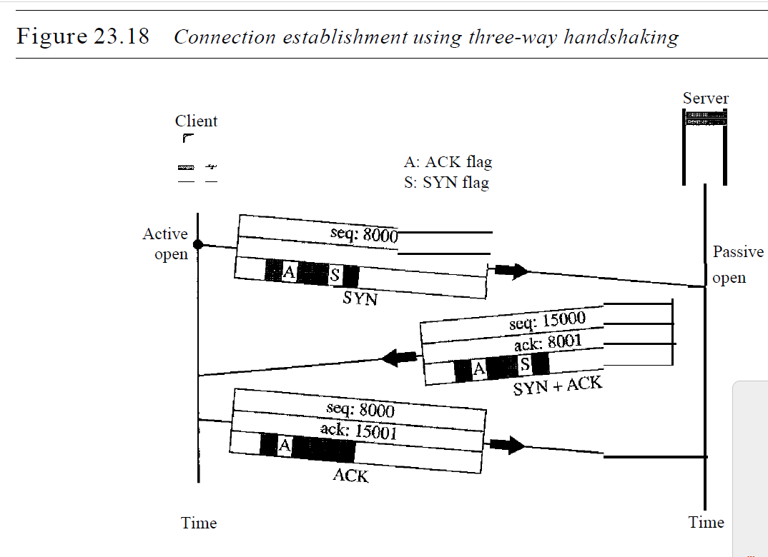

Slide 5
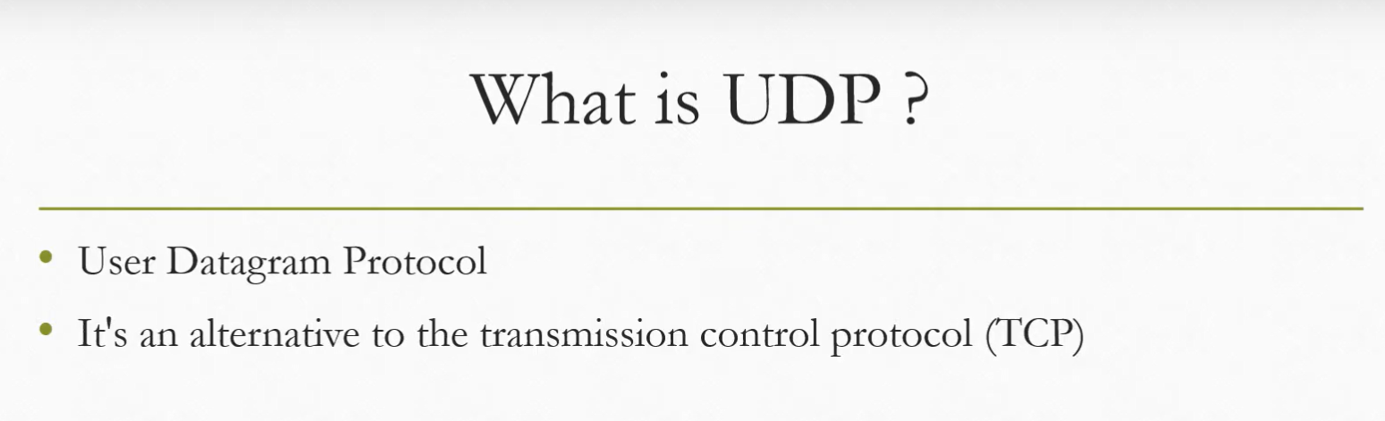

Slide 6
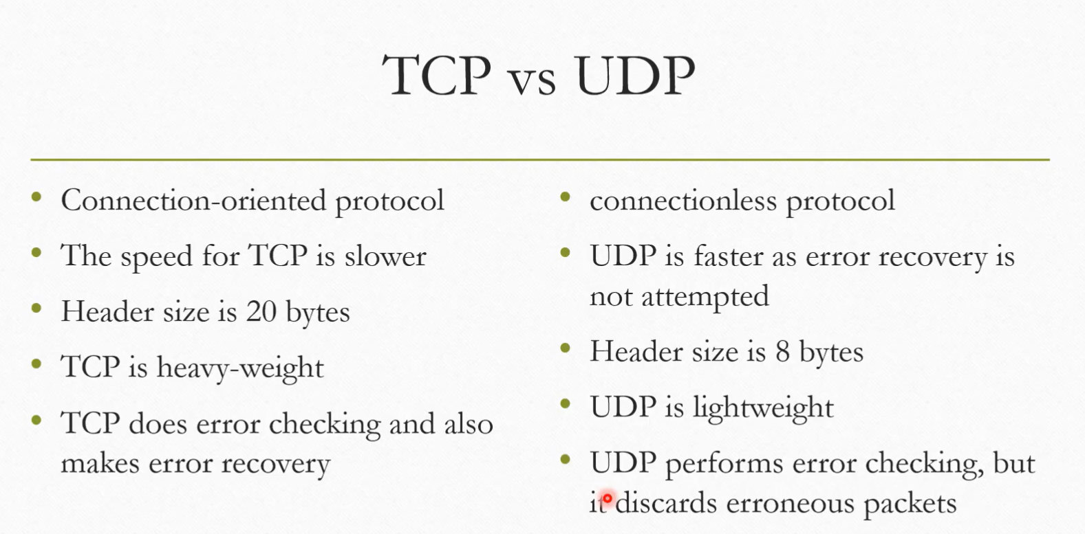

Slide 7
Congestion Control
Technique or mechanism to
Prevent before it happens
Remove after it has happened
TYPES:
Open loop congestion control(prevention)
Closed loop congestion control(Removal)

Slide 8
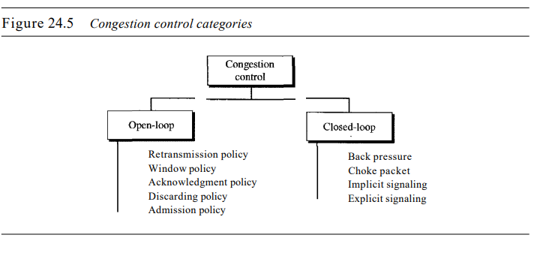

Slide 9
Retransmission Policy
Retransmission is sometimes unavoidable. If the sender feels that a sent packet is lost or corrupted, the packet needs to be retransmitted. Retransmission in general may increase congestion in the network. However, a good retransmission policy can prevent congestion. The retransmission policy and the retransmission timers must be designed to optimize efficiency and at the same time prevent congestion.

Slide 10
Window Policy
The type of window at the sender may also affect congestion. The Selective Repeat window is better than the Go-Back-N window for congestion control

Slide 11
Acknowledgment Policy
The acknowledgment policy imposed by the receiver may also affect congestion. If the receiver does not acknowledge every packet it receives, it may slow down the sender and help prevent congestion.

Slide 12
Discarding Policy
A good discarding policy by the routers may prevent congestion and at the same time may not harm the integrity of the transmission. For example, in audio transmission, if the policy is to discard less sensitive packets when congestion is likely to happen, the quality of sound is still preserved and congestion is prevented or alleviated.

Slide 13
Admission Policy
An admission policy, which is a quality-of-service mechanism, can also prevent congestion in virtual-circuit networks. Switches in a flow first check the resource requirement of a flow before admitting it to the network. A router can deny establishing a virtual circuit connection if there is congestion in the network or if there is a possibility of future congestion.

Slide 14
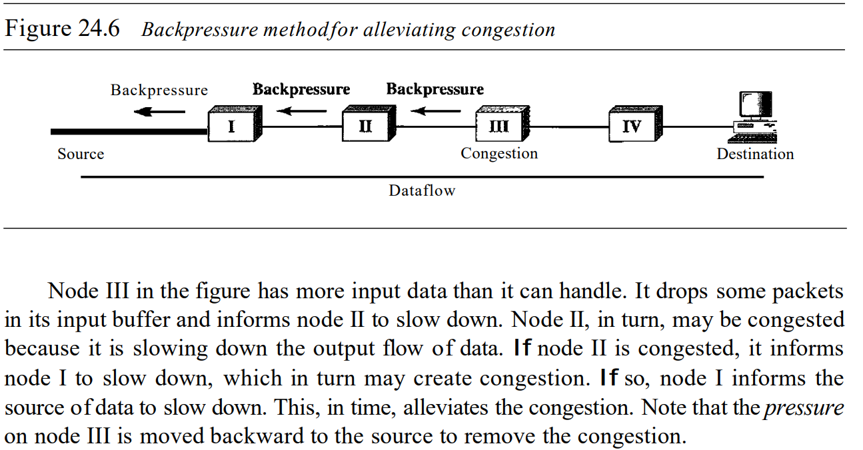
Closed loop control

Slide 15
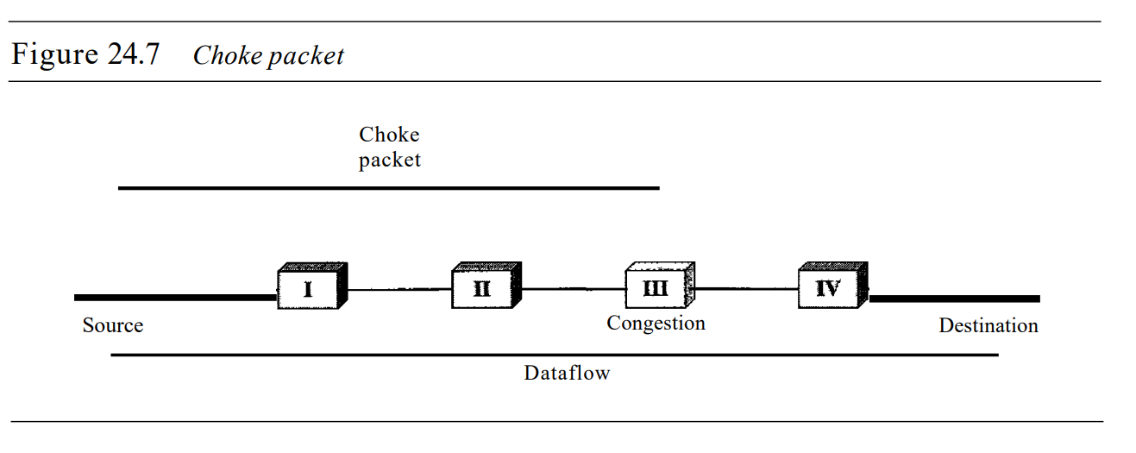
A choke packet is a packet sent by a node to the source to inform it of congestion. Note the difference between the backpressure and choke packet methods. In backpressure, the warning is from one node to its upstream node, although the warning may eventually reach the source station. In the choke packet method, the warning is from the router, which has encountered congestion, to the source station directly

Slide 16
Implicit Signaling
In implicit signaling, there is no communication between the congested node or nodes and the source. The source guesses that there is a congestion somewhere in the network from other symptoms. For example, when a source sends several packets and there is no acknowledgment for a while, one assumption is that the network is congested. The delay in receiving an acknowledgment is interpreted as congestion in the network; the source should slow down
Ex: TCP

Slide 17
Explicit Signaling
The node that experiences congestion can explicitly send a signal to the source or destination. The explicit signaling method, however, is different from the choke packet method. In the choke packet method, a separate packet is used for this purpose; in the explicit signaling method, the signal is included in the packets that carry data.
Ex: Frame delay congestion control

Slide 18
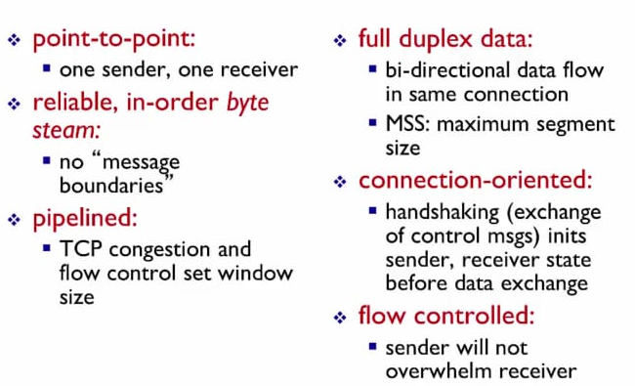
Transmission control Protocol-TCP

Slide 19
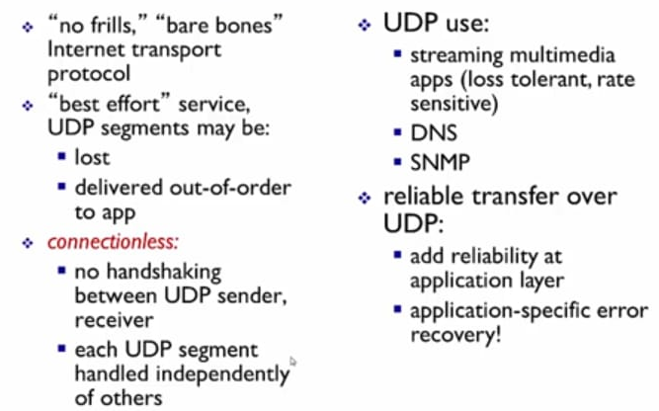
User Datagram Protocol-UDP

Slide 20
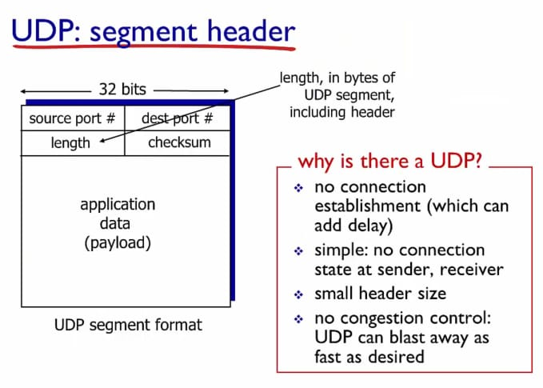

Slide 21
